Slide 1

What Do The Numbers Mean?
An overview of financial administration within Parish life
Presented by: Iryna Laschuk, Director of Finance

Slide 2
OBJECTIVE
Review, discuss and understand the key areas of responsibility in the financial administration of a Parish including:
Why is financial health important?
Who is responsible for the financial duties in a Parish?
What do the numbers mean? What tools can we use?
When is financial information reported?
How to monitor the financial health of our Parishes?
Where do we get help?

Slide 3
1. WHY FINANCIAL HEALTH?
Both Civil and Canon Law require a level of financial oversight to ensure stewardship of the temporal goods of a Parish.
Canon Law entrusts this stewardship to the Pastor who represents the Parish and the Bishop. The Bishop has ultimate responsibility for all parishes in the Eparchy
Civil law, applied primarily by the Canada Revenue Agency, requires all charitable organizations maintain specific reporting standards to protect their status as a charity or society and all donors
Parishioners expect the highest level of stewardship of the monies they donate and raise to meet the needs and growth of their Parish
Parish financial viability requires financial health, otherwise a parish may not be able to continue to serve its parishioners
Financial Health is a matter of Service not Power

Slide 4
2. WHO IS RESPONSIBLE?
BISHOP
PARISH
PASTOR
Pastoral
Council
Finance Committee
Parishioners

Slide 5
Role of the Eparchy & Parishes
Eparchy:
Execute the pastoral works of the Bishop
Support Parishes through combined religious education, youth, & liturgical ministries etc.
Support Parishes in administration of payroll, insurance, safer environments etc.
Support Parishes with major projects and/or initiatives
Eparchy
Parishes
(rural)
Parishes
(urban small)
Eparchial Organizations
Parishes (urban large
Parishes
Build, nurture and grow our faith- based church community
Support our Bishop in his pastoral works
Financially support Parish Life
Financially support Eparchy through the designated contributions
Support events and activities around the Eparchy
We are ONE Family

Slide 6
3. WHAT DO THE NUMBERS MEAN?
In this section, we will:
  Discuss the importance of planning, monitoring and reporting your Parish’s finances
  Present samples of three main financial tools:
    Income Statement (what you earn)
    Budget (what you have planned)
    Balance Sheet (what you own)
  Review sample statements, and discover “What the Numbers Mean”

Slide 7
Basic Financial Process
Record & Monitor
Report & Analyze
Plan
Financial Health is less about finances and more about communication

Slide 8
Income Statement (Profit and Loss)
Refer to Example 1 (next page)
Summarizes:
How much you EARN (Revenue)
LESS how much you SPEND (Expenses)
EQUALS PROFIT or LOSS
Some revenue and expenses are the same each year (Sunday Collections, Pastoral Stipend, utilities, repairs and maintenance)
Some revenue and expenses are unique (Fundraising campaign, major evangelization or renovation project)
Identifying and actioning trends leads to better monitoring of financial health and decision making

Slide 9
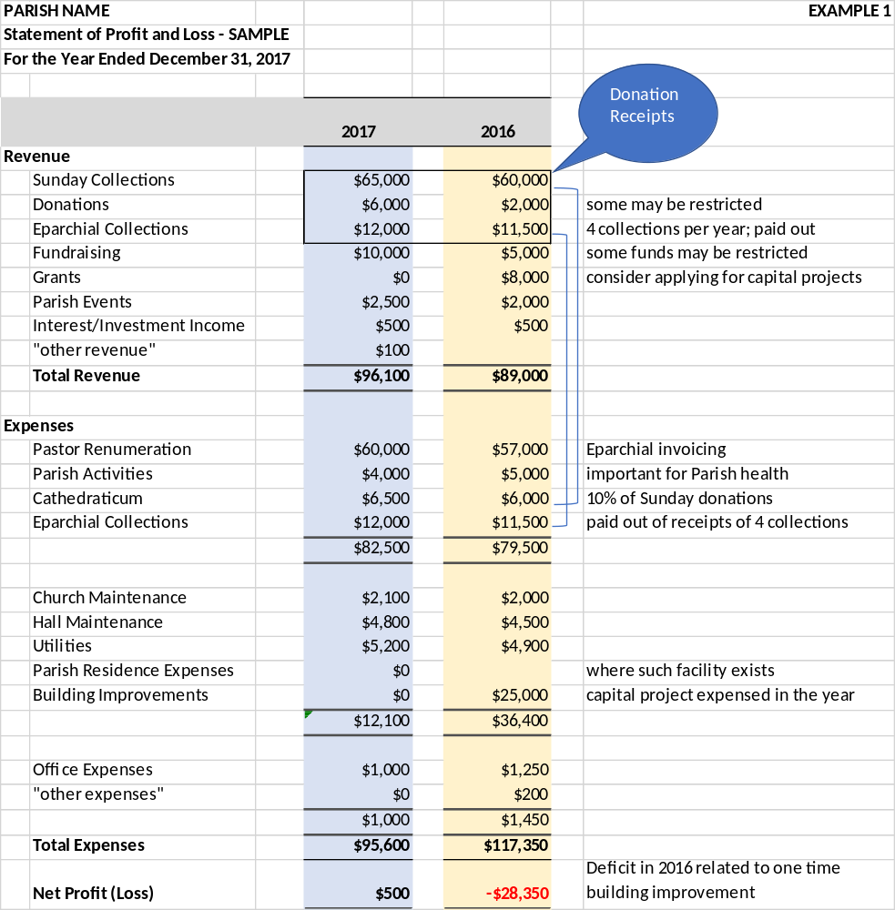

Slide 10
Budget
Refer to Example 2
(next page)
A budget is the plan for the parish by which the pastor and council can manage the financial health of parish activities
Budgets are typically approved by the pastor, pastoral council and parishioners (financial mandate)
To build a budget:
  use your prior year results and update based on future projections (i.e. cost of living increases)
  Include specific initiatives (additional fundraising, major project)
NOW WHAT?
Quarterly, use your budget to compare your plan to actual results for the period. Any difference is called a variance.
Variances must be addressed on a timely basis, and in some cases actioned through spending or budget adjustments

Slide 11
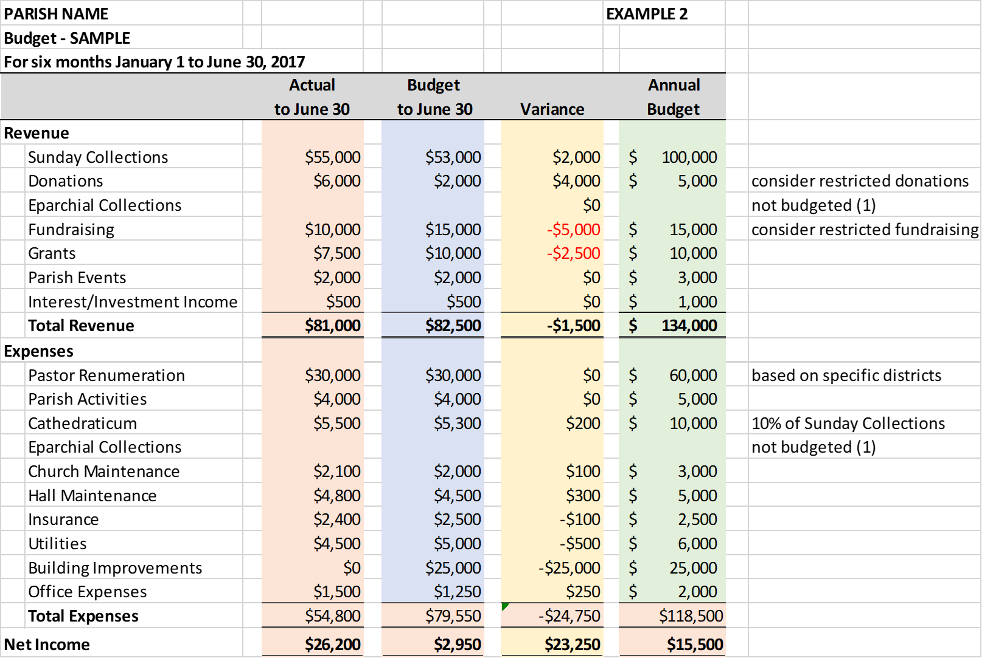

Slide 12
Balance Sheet(or Statement of Net Worth)
Refer to Example 3
(next page)
Provides a NET WORTH of your Parish:
    What you OWN (Assets)
    LESS What you OWE (Liabilities)
    EQUALS your EQUITY (Net Worth)
What you OWN includes cash, investments, buildings, land, art work, equipment; many not for profit organizations (i.e. parishes) only report their cash and investments as all “fixed asset” purchases are expensed in the year bought (but these assets should be tracked)
What you OWE includes any loans or outstanding bills
Liquid assets (cash and investments), in the amount of one years expenses is recommended as a “rainy day fund”

Slide 13
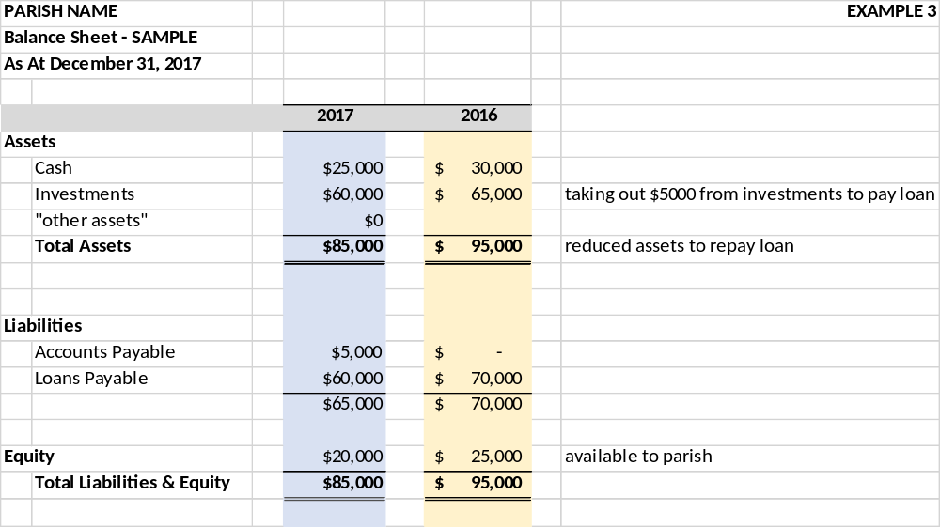

Slide 14
Understanding Financial Health
Financial statements report the historical operations of your Parish. Ask yourself these questions:
  How much does it cost to operate your Parish?
  How much is raised from donations, fundraisers and other means? Is it enough?
  Are you meeting your financial obligations to support the Eparchy and other religious organizations?
  Are you maintaining a consistent Equity balance?
From these reports you can also assess future financial health:
  Are you meeting your financial obligations annually? Y/N
  Are your revenues stable from year to year (trend)? Y/N
  Are major capital projects planned/needed? Y/N
  Do you carry a reserve? Is it enough? Y/N
  What is your plan for the future?
Profit and Loss & Balance Sheet

Slide 15
4. WHEN IS FINANCIAL INFORMATION REPORTED?
At minimum an Income Statement and Balance Sheet must be prepared annually.
Financial statements should be reviewed by at least two people acting, who are not on council, to ensure they represent the financial operations and presented at an annual general meeting.
For Parishes registered as a Charitable Organization or Not For Profit with CRA, they must submit financials statements and Charity Return (T3010) within 6 Months of their year end
Copies of the financial statements and the Charity Return are to be forwarded to the Eparchial Office, annually

Slide 16
5. HOW TO MONITOR FINANCIAL HEALTH
PROCEDURALLY
Ensure that your parish has bylaws, policies and/or procedures in place
Ensure competent people are placed in charge of record keeping and reporting
Ensure that two people sign all cheques (the pastor and one council member) except for gaming accounts or if the pastor is away; ensure two people conduct the count of donations
FINANCIALLY
Ensure you clearly understand the annual financial statements (take part in the annual audit review)
Ensure the income statement is presented at least quarterly at a Pastoral Council meeting and any deviation from the budget explained
Look at the trends from year to year and make decisions

Slide 17
6. WHERE TO GET HELP
Access expertise within your parish
Contact the Chancery office; we will walk through the recommended Eparchial protocols for good financial management and stewardship
Access external courses, where available

Slide 18
OVERVIEW
Financial Health of a Parish is important to parish growth and viability
The Pastor, has ultimate stewardship of the financial activities of your Parish (establishing processes and monitoring financials)
Every Parish is obligated to submit all annual financial statements and reporting to their parishioners, the Bishop and CRA or other government bodies.
Every Parish must meet their financial obligations including timely payment of the cathedraticum and forwarding monies from other collections
Every Parish must be active in addressing possible issues with their cash flow, budget and financial health;
When needed, ask for assistance

